Slide 1
Build a system to classify
an object of a RGB image
Project COSC 6324

Slide 2
Team Members
Venkata Santosh Valli Sunkarapalli
Valluri Shalini
Valluri sai Prasanna
Veerla Sri Nikitha

Slide 3
Introduction
The project involves the development of a system to classify objects within RGB images.
The dataset (D) consists of 10,000 RGB images, each with a dimension of 32x32x3.
The corresponding class labels (y) categorize the images into one of ten classes:
airplane, automobile, bird, cat, deer, dog, frog, horse, ship, truck

Slide 4
Objective
Develop an effective classification system capable of accurately identifying objects within RGB images.
Implement a Convolutional Neural Network (CNN) architecture to extract relevant features and patterns from the images.
Achieve a high classification accuracy on the test dataset to demonstrate the system's robustness and effectiveness.

Slide 5
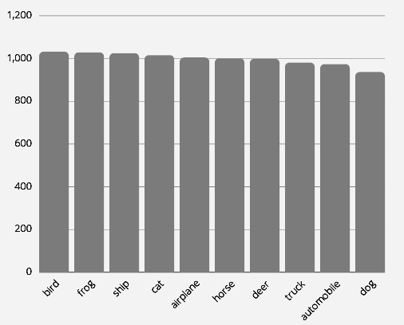
Visualizing Data
Each class represents a
distinct object category.
The dataset comprises a total
of 10,000 RGB images.
The number of samples varies
for each category,
highlighting potential class
imbalances.

Slide 6
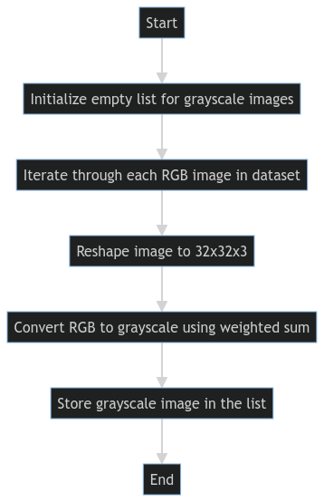
Data Preprocessing

Slide 7
Data Preprocessing
Initialize List:
Start by initializing an empty list to store grayscale images.
Iterate Through Dataset:
Loop through each RGB image in the dataset to process them individually.
Reshape Images:
Reshape each image to the size of 32x32x3 to ensure uniformity for further processing.
Convert RGB to Grayscale:
Use a weighted sum method to convert RGB images to grayscale, simplifying the data while retaining essential features.
Store Grayscale Images:
Save the processed grayscale images in the previously initialized list, ready for model training and evaluation.

Slide 8
CNNs
Convolutional Neural Networks (CNNs) are a type of deep learning architecture specifically engineered for handling structured grid-like data, such as images.
These networks consist of multiple layers, including convolutional layers, pooling layers, and fully connected layers. CNNs excel in learning hierarchical features from visual data, effectively capturing complex patterns and details within images.
They utilize operations like convolution, ReLU activation, and pooling to extract and retain critical spatial information. CNNs have significantly advanced the field of computer vision, leading to major breakthroughs in applications such as image classification, object detection, and image segmentation.

Slide 9
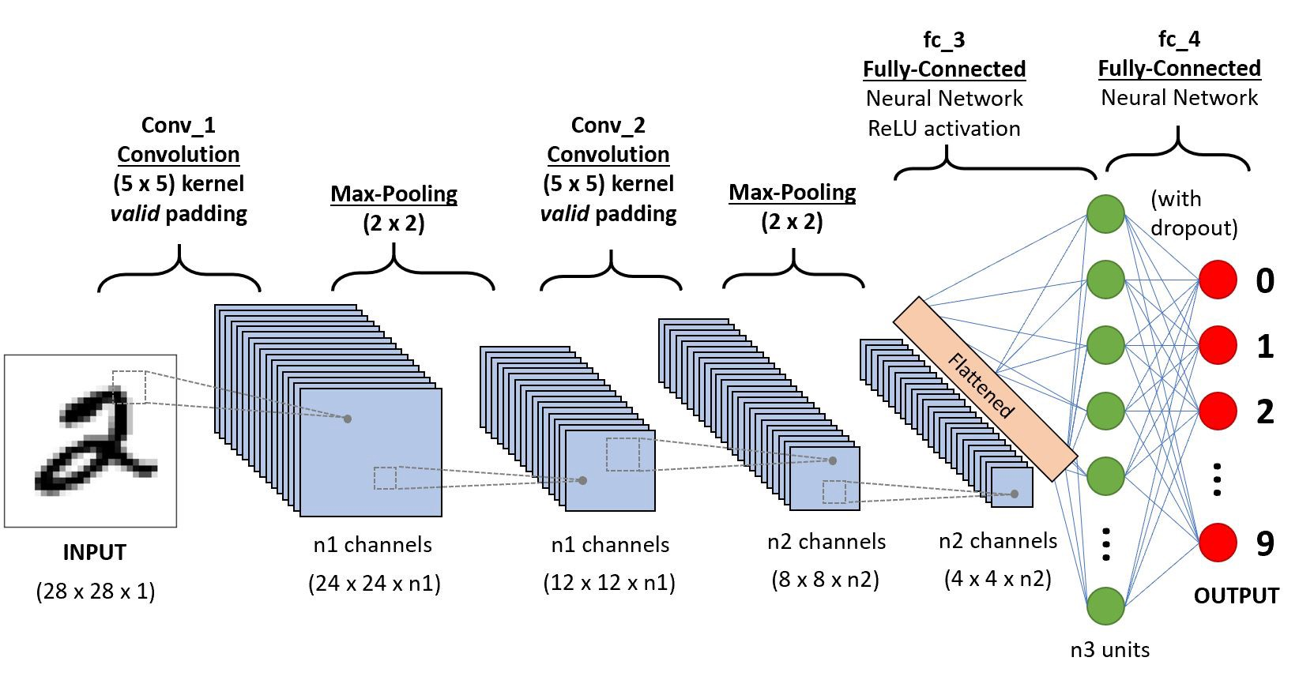
CNN Architecture
The CNN is composed of five convolutional layers. Each layer is followed by a ReLU activation function and a max pooling layer.
The number of filters in the convolutional layers increases progressively from 32 to 512.
Each convolutional layer uses a 3x3 kernel size with padding.
After the convolutional layers, the network applies an adaptive average pooling layer to reduce the spatial dimensions to 1x1.
The first fully connected layer has 512 neurons and is followed by a ReLU activation function.
The final layer has 10 neurons, corresponding to the number of classes in the classification task.

Slide 10
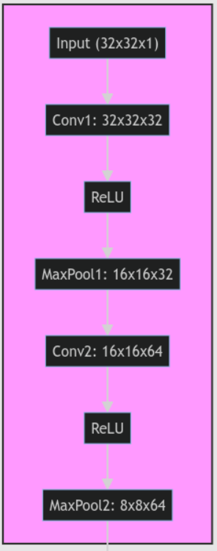
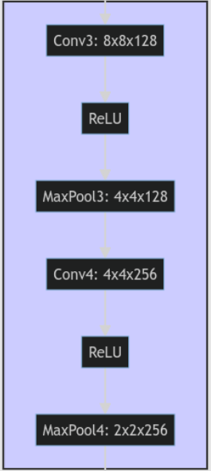
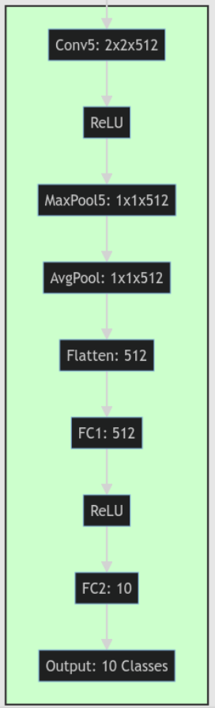

Slide 11
Terms related to CNNs
ReLU
The use of ReLU activation functions introduces non-linearity, helping the network learn complex patterns.
Max pooling
The max pooling layers reduce the spatial dimensions, controlling overfitting and reducing computational cost.
Fully connected layers
The fully connected layers at the end perform the final classification based on the high-level features extracted by the convolutional layers.

Slide 12
Training the model
Initialize the CNN model and define the Cross Entropy Loss function.
Use the Adam optimizer with a learning rate of 0.001 for optimization.
Iterate through the training data for a specified number of epochs.
Compute the outputs and loss, perform backpropagation, and update the model parameters.
Monitor the gradient norm and stop training if it falls below a specified threshold.

Slide 13
Training the model
Training Hyperparameters
Loss Function: Cross Entropy Loss
Optimizer: Adam
Learning rate: 0.001
Number of epochs: 10
Batch size: 1 (for DataLoader)
Gradient Norm Threshold Value: 1.0 x 10⁻⁴ (for early stopping based on gradient norm)

Slide 14
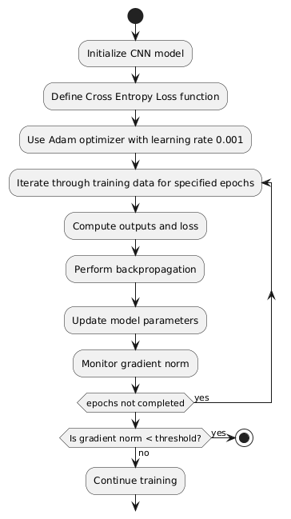
Training the model

Slide 15
Training loss
Loss in Training
Loss represents the error or the inconsistency between the predicted output of the model and the actual target labels in the training data. It is crucial to minimize the loss during training as it reflects the model's ability to make accurate predictions and adjust its parameters accordingly.
Why Track Loss?
Tracking loss helps in assessing the model's performance and convergence during the training process.
It aids in evaluating the effectiveness of the chosen optimization algorithm and learning rate.

Slide 16
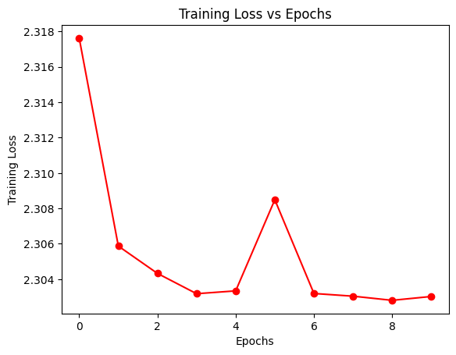
Calculation of Loss in Training
We calculated the loss using the Cross Entropy Loss function, The loss was computed for each batch of training data and then averaged to monitor the overall training progress which is commonly used for multi-class classification tasks.
The loss was computed for each batch of training data and then averaged to monitor the overall training progress
Training Loss decreases with increase in number of epochs

Slide 17
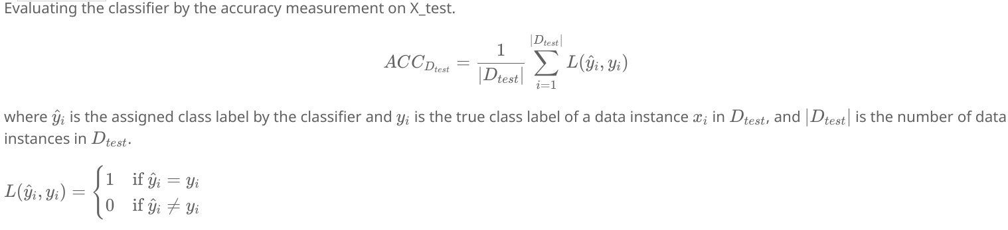
Testing Procedure

Slide 18
Pros and Cons
Pros: Learns complex hierarchical features through deep architecture. Utilizes max pooling layers for downsampling while retaining crucial features. Employs ReLU activation to speed up convergence and address the vanishing gradient problem. Handles variable-sized input images with adaptive average pooling. Possesses a large model capacity to capture intricate patterns in the data. | Cons: May overfit on small datasets if not properly regularized. Requires substantial computational resources. Can experience vanishing or exploding gradient issues that affect convergence. Understanding model decisions can be difficult due to limited interpretability. Performance is highly sensitive to the choice of hyperparameters.

Slide 19
Future scope
Data augmentation involves increasing the diversity of training data to improve the model's ability to generalize.
Regularization techniques, such as dropout or batch normalization, are employed to reduce overfitting. Hyperparameter tuning requires an exhaustive search to determine the best values for parameters like learning rate, batch size, and regularization strength.
Combining predictions from multiple models, known as model ensembling, can lead to better performance.
Transfer learning utilizes pre-trained models, adapting them to your specific dataset through fine-tuning.
Gradient clipping is used to stabilize training by preventing issues like gradient explosion or vanishing, thereby enhancing convergence.

Slide 20
References
https://www.techtarget.com/searchenterpriseai/definition/convolutional-neural-network
https://towardsdatascience.com/convolutional-neural-networks-explained-9cc5188c4939
https://www.geeksforgeeks.org/introduction-convolution-neural-network/
https://youtu.be/KuXjwB4LzSA
https://www.youtube.com/watch?v=py5byOOHZM8

